Slide 1
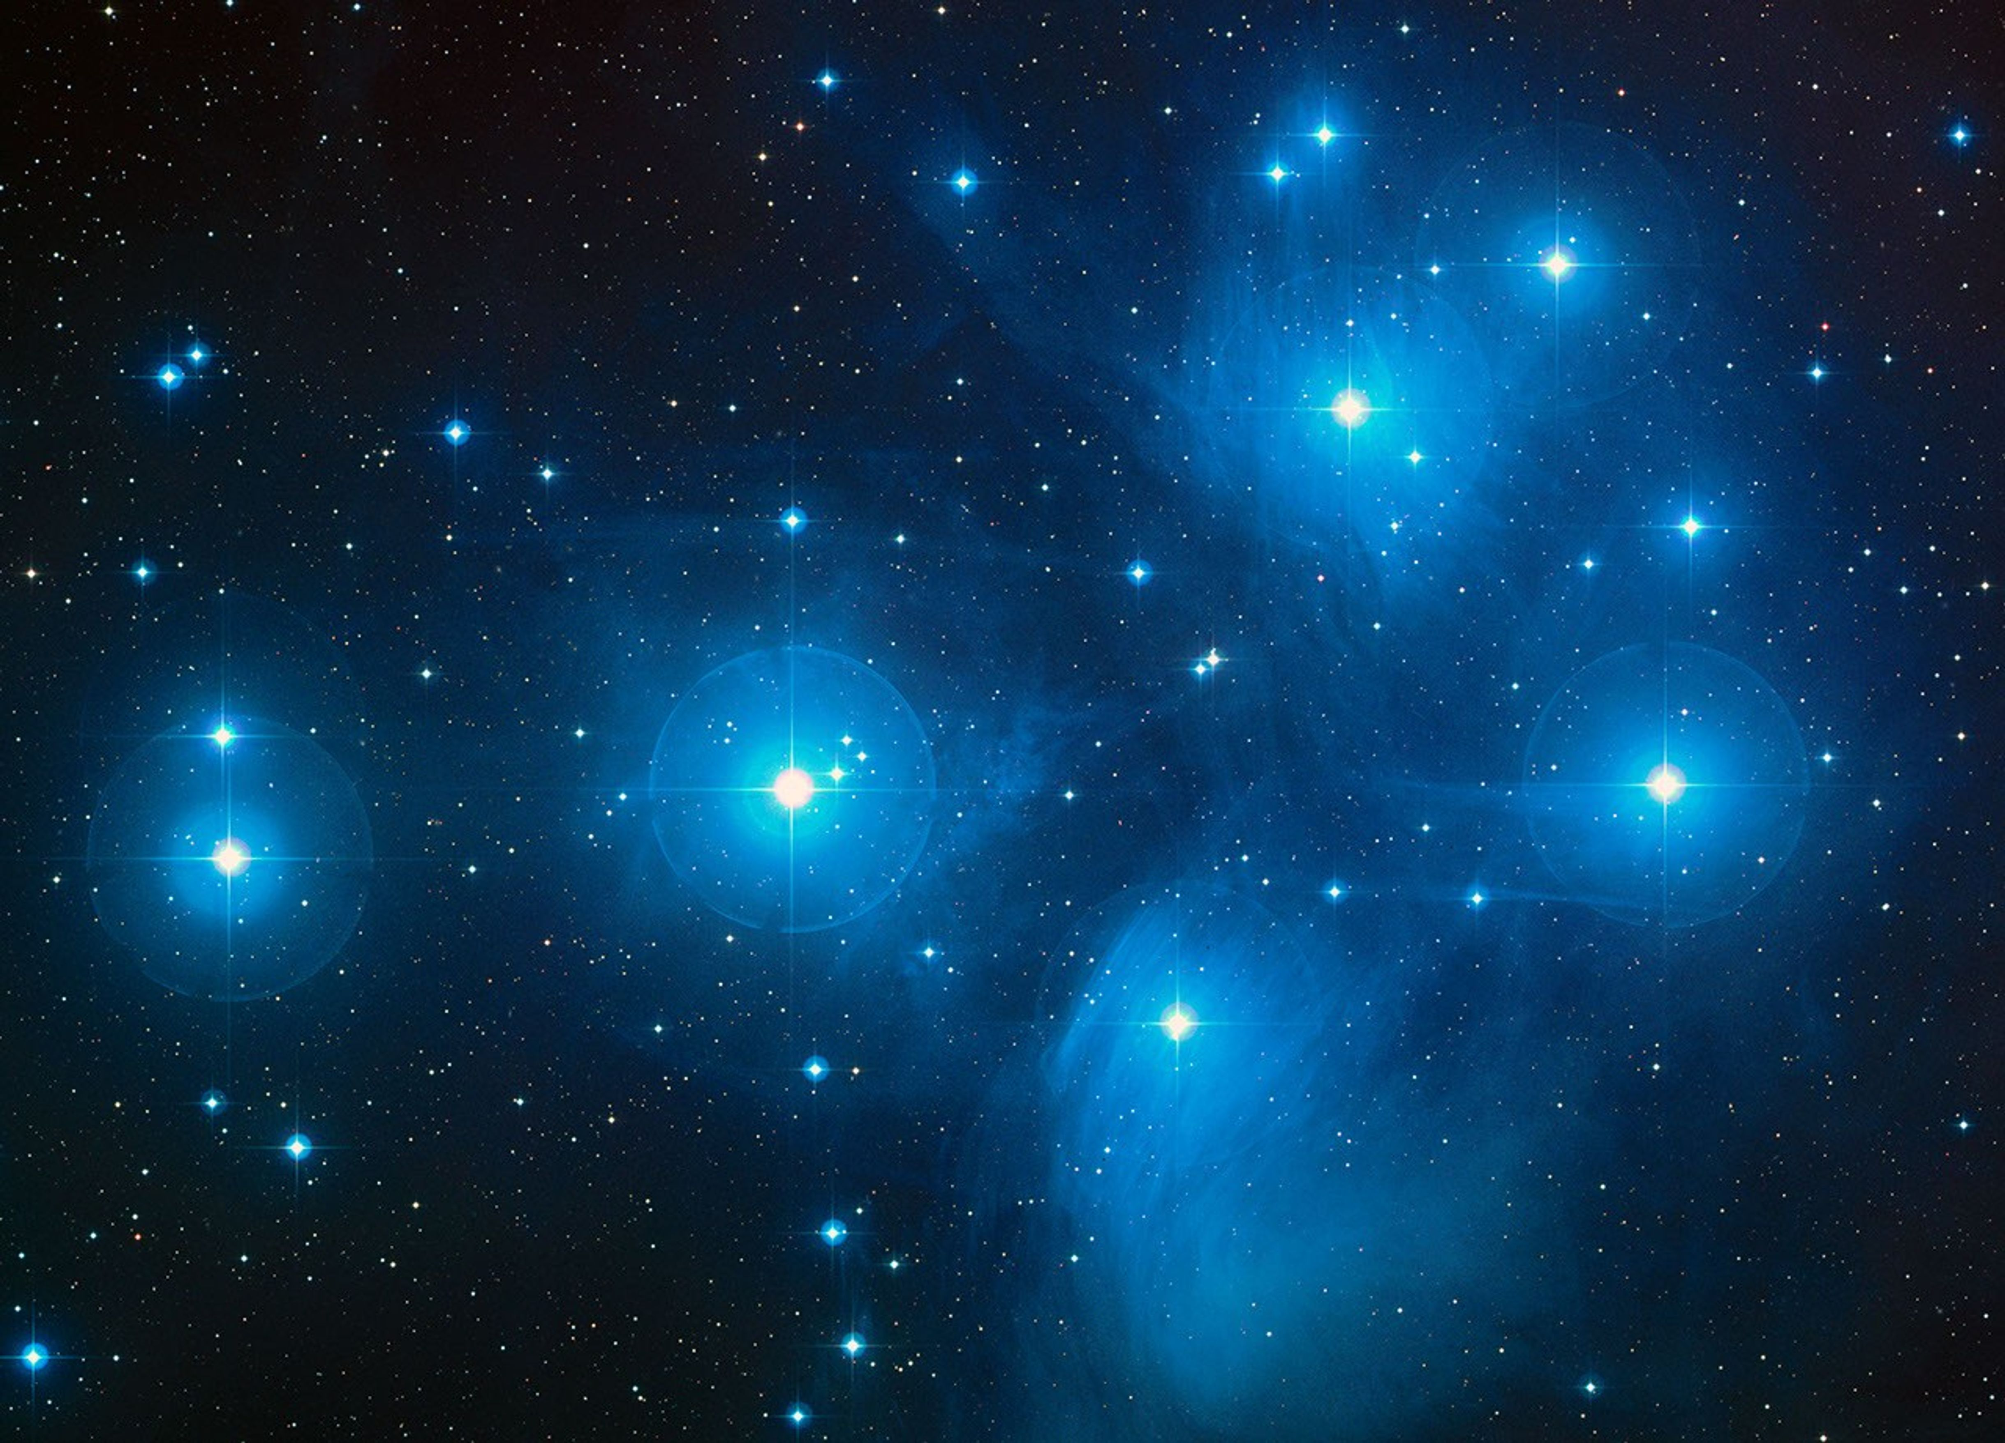
Determining the Orbital Periods in a Multi-Star Eclipsing System
Swastika Sanghi (23123045)
Dhairya Kotecha (23123014)

Slide 2
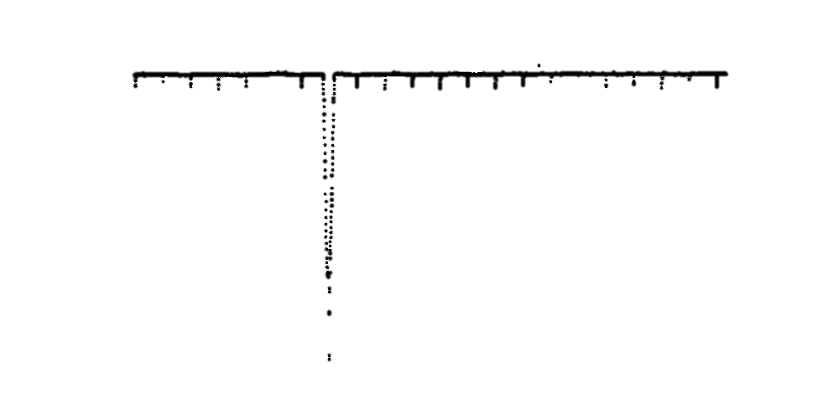
Idea
Decomposing a compact triply eclipsing hierarchical triple star system into its composite pairs using the Lomb-Scargle periodogram technique (a direct extension of classical Fourier analysis for unevenly sampled time series data in astronomy).
We have used an artificially simulated system, a simulated system inspired from a real system EPIC 249432662, and the real data of this system.

Slide 3
Motivation
We drew inspiration for this analysis from reading about the properties of stars in multi star systems, which are determined by the mutual gravitational influences.
A recent discovery of the orbiting partner of Betelgeuse, based on the Great Dimming event (S. B. Howell et al., 2025), further piqued our interest.

Slide 4
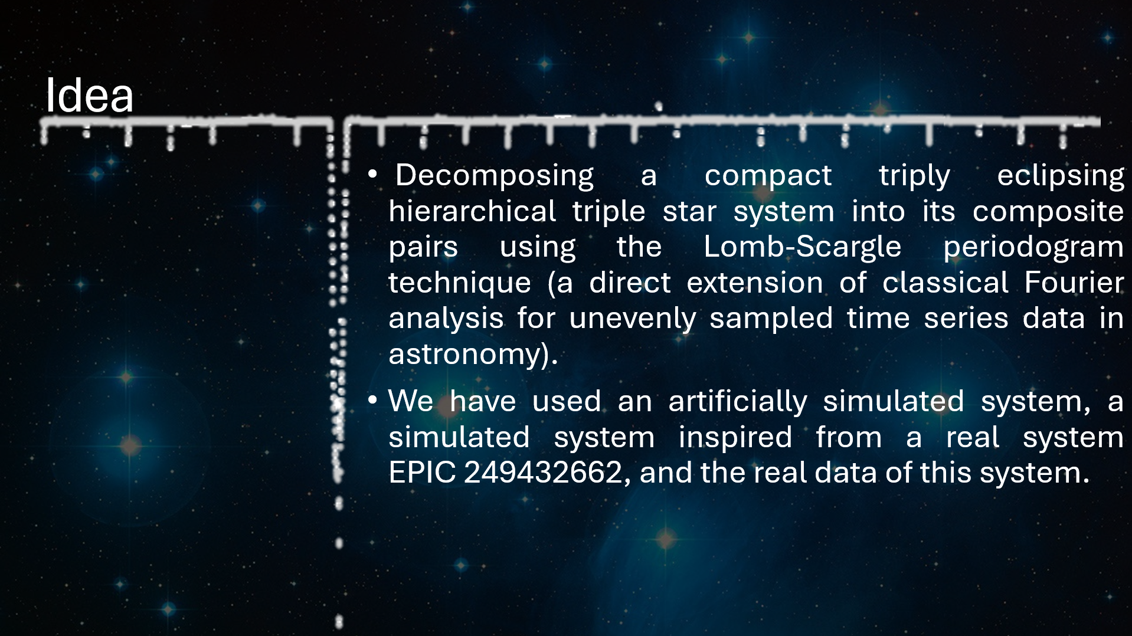
Explaining the System
Triple Star System : Our solar system has only one star – the Sun. But this is not how all stellar systems are. In fact, most of the systems that we have found are either binary – there are two stars gravitationally bound to each other – or they are triplets, quartets, quintets and even sextets and septets.
The systems that we are analyzing are triplets. Though more nuanced than binaries, triplets are still computable in limited time with limited resources and computation.
Eclipsing : As these systems are gravitationally bound, they orbit a barycentre. From some points-of-view, one star can be seen eclipsing the other – it passes in front of the other star and blocks it light. The plane of the stars’ orbits is edge-on in this point-of-view.

Slide 5
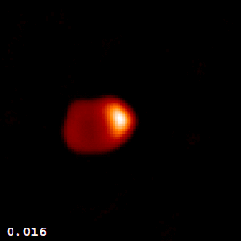
Notes:
Reference : Dr. Fabien Baron, Dept. of Astronomy, University of Michigan, Ann Arbor, MI 48109-1090

Slide 6
Explaining the System
Hierarchical : Stars are arranged in nested orbits, with closer pair orbiting a common centre of mass, and a third (or higher order) body orbiting this pair at a much larger distance. Thus, the outer star cannot enter the orbit of the inner pair at any instant.
Due to the significant separation, the gravitational influences between the inner orbits and outer orbits are small, so that the system obeys Kepler’s laws, and any two consecutive levels can be simplified as a two-body problem. So, we find minimum perturbations in the motion of these bodies and the analysis becomes more convenient.

Slide 7
Explaining the System
Triply (eclipsing) : All the three stars eclipse each other at some point of time.
So, we can find out the respective time periods for all the orbits.
Compact : The ratio of the outer time period to the inner time period is small.
The advantage of using a compact system is that since the time periods are small, we can observe a clear pattern in a shorter span of time. Otherwise, there are chances that we completely miss an outer star.

Slide 8
Why Starting with a Simulation?
Using simulated data is helpful to test the methodology confidently and validate the results, as we have set the parameters and we know the original time periods to check if the analysis recovers them correctly.
It also helps to illustrate the concepts to an audience for the first time without the complexities that are inherent in real observational data.
But the parameters that we have used are not far from the real world. Interestingly, the real-world system that we have chosen for analysis is close to an ideal world!

Slide 9
Explaining the Simulation
Parameters Selected
Inner binary period : 2.5 days (with primary and secondary eclipses)
Outer orbital period : 127.3 days (third star eclipsing the binary)
Additional periodicity : 45.2 days (ellipsoidal variation)
Time baseline : 730 days (2 years)
Number of observations : 1000 data points
Added realistic photometric noise : σ = 0.01 magnitudes
Notes:
292, 5, 16;

Slide 10

Introducing the Lomb-Scargle Periodogram
The Lomb-Scargle method analyzes the problem as a least-squares fitting problem for every frequency$ω$.
For a given frequency $ω$, we attempt to fit a simple sinusoidal model$h(t)$to the $N$ observed data points $x_{n}$ at times $t_{n}$.
The LSP power $P_{\text{LS}}\left(ω\right)$ is proportional to the variance reduction achieved by this best-fit model.

Slide 11

Derivation Part 1:
Our objective is to minimize the Error Function ($E$) : $E\left(A,B\right)=\sum_{n=1}^{N}{{\left[\left(x_{n}−\overline{x}\right)−h\left(t_{n}\right)\right]}^{2}}$
This requires solving for $A$ and $B$ by setting $∂E / ∂A = 0 and ∂E / ∂B = 0$
This minimization yields complicated, coupled equations because of the non-orthogonal cross-term : $S_{\text{cross}}=\sum_{n=1}^{N}{}\cos\left(ωt_{n}\right)\sin\left(ωt_{n}\right)$
DFT vs. LSP : DFT works because this term $≈0$ for uniform data. LSP must explicitly fix this for uneven data.

Slide 12

Derivation Part 2:
The Solution ($τ$): We introduce a frequency-dependent phase shift $τ$ into the model to force the cross-term to zero, thus making the $\sin{}$ and $\cos{}$ components orthogonal.
The Phase Shift Equation: $τ$ is chosen to satisfy the orthogonality condition, leading to : $\tan\left(2ωτ\right)=\frac{\sum_{n=1}^{N}{}\sin\left(2ωt_{n}\right)}{\sum_{n=1}^{N}{}\cos\left(2ωt_{n}\right)}$

Slide 13

The Final Lomb-Scargle Equation
With $τ$ ensuring a clean, decoupled least-squares fit, and proper normalization by the data variance $σ^{2}$, the final LSP power is:
$$P_{\text{LS}}\left(ω\right)=\frac{1}{2σ^{2}}\left\{\frac{{\left[\sum_{n=1}^{N}{\left(x_{n}−\overline{x}\right)}\cos\left(ω\left(t_{n}−τ\right)\right)\right]}^{2}}{\sum_{n=1}^{N}{}\cos^{2}\left(ω\left(t_{n}−τ\right)\right)}+\frac{{\left[\sum_{n=1}^{N}{\left(x_{n}−\overline{x}\right)}\sin\left(ω\left(t_{n}−τ\right)\right)\right]}^{2}}{\sum_{n=1}^{N}{}\sin^{2}\left(ω\left(t_{n}−τ\right)\right)}\right\}$$

Slide 14
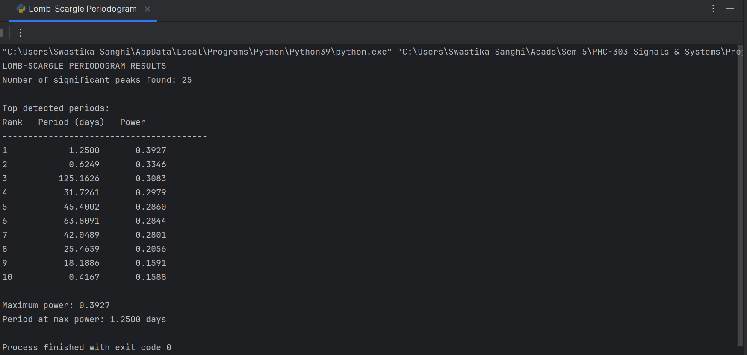
Result of Analysing the Simulated System
What does Power mean here?
Why do we get the half of the inner period?
Then, we should’ve also got the half of the outer period.
Why is inner subsystem’s signal stronger?
But can such systems be real in terms of luminosity order or orbital periods?
Notes:
Example : Alpha Centauri, EPIC

Slide 15
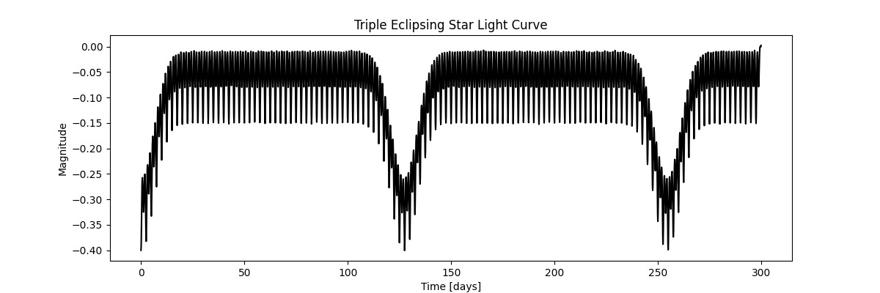
Light Curve of the Simulated System

Slide 16
EPIC 249432662
Inner Binary Period : 8.23 days
Outer Binary Period : 188 days
Time Baseline : 80 days
No. of Data Points : ~4000
Inner Eclipse Depth : 3%
Outer Eclipse Depth : 50%
Outer Eclipse Duration : 1.7 days
Notes:
Spectroscopic types : M, M, K; Mutual inclination = 0.17 degrees

Slide 17
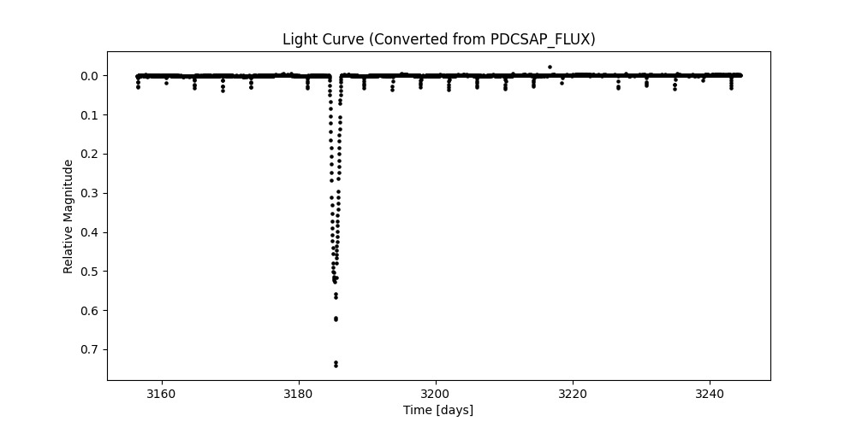
EPIC 249432662 Light Curve (using complete data)

Slide 18
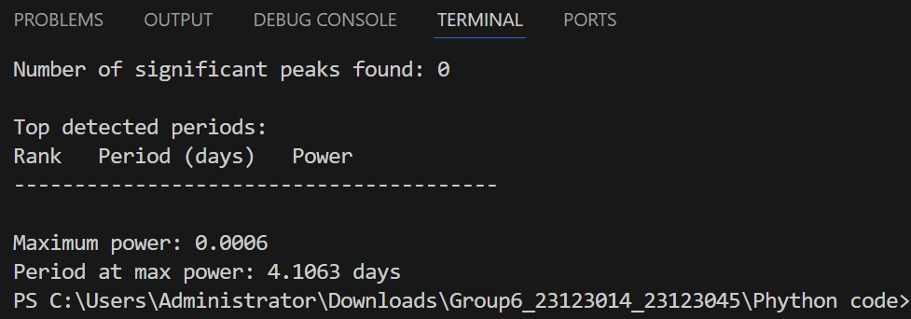
Applying Lomb-Scargle on the Smaller Section of EPIC 249432662

Slide 19
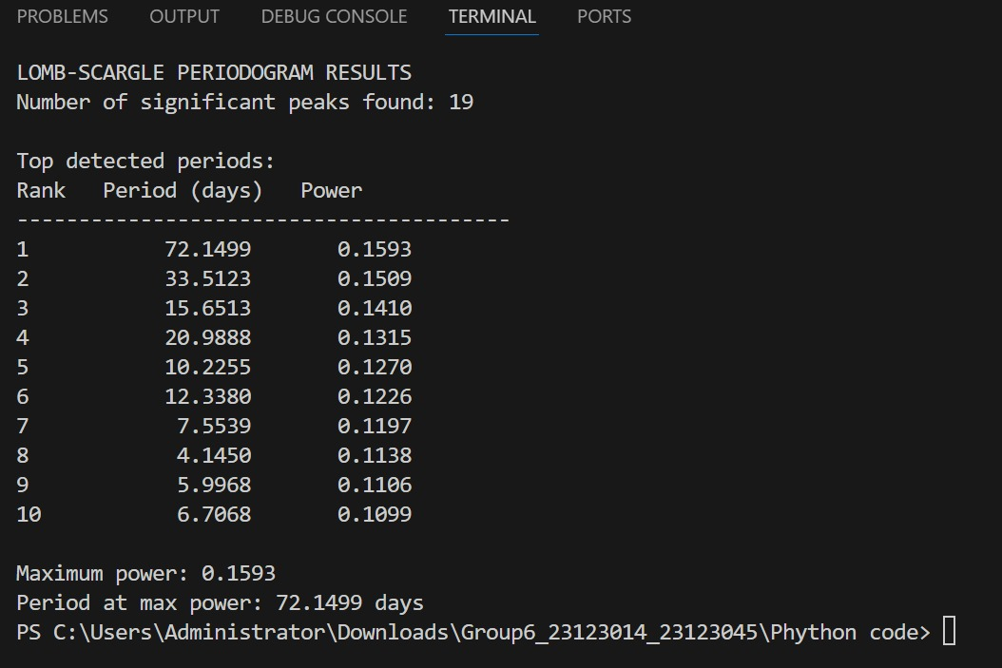
What will happen if we apply Lomb-Scargle on complete data?
Notes:
It will not be able to generate much useful results because the big ellipse is not being repeated, only 80 day data, not enough to show periodicity of 188 periods. So detects many false peaks, but still able to detect the 2nd harmonic of 8.23 day period at the 8th position. Fourier mein toh yeh bhi nahi aayi thi.

Slide 20

Why not Fourier?
The DFT decomposes a time-series $x_{n}$ into its constituent sine and cosine waves.
$$X\left(ω\right)=\sum_{n=1}^{N}{x_{n}e^{−iωt_{n}}}=\sum_{n=1}^{N}{x_{n}\left[\cos\left(ωt_{n}\right)−i\sin\left(ωt_{n}\right)\right]}$$
The power (or intensity) at a frequency $ω$ is proportional to the magnitude squared of the DFT coefficients: $P_{DFT}\left(ω\right)∝{\left|X\left(ω\right)\right|}^{2}$
Critical Assumption: The data points $x_{n}$ must be collected at uniformly spaced times $t_{n}$.

Slide 21
Why not Fourier?
The spectral window itself contains many arbitrary peaks related to the spacing of the gaps. When the true signal's spectrum is convolved with this spectral window, these spurious peaks are transferred, creating aliasing.
The complex shape of the spectral window smears the power from the true frequency across nearby frequencies, resulting in low, wide peaks (power leakage).

Slide 22
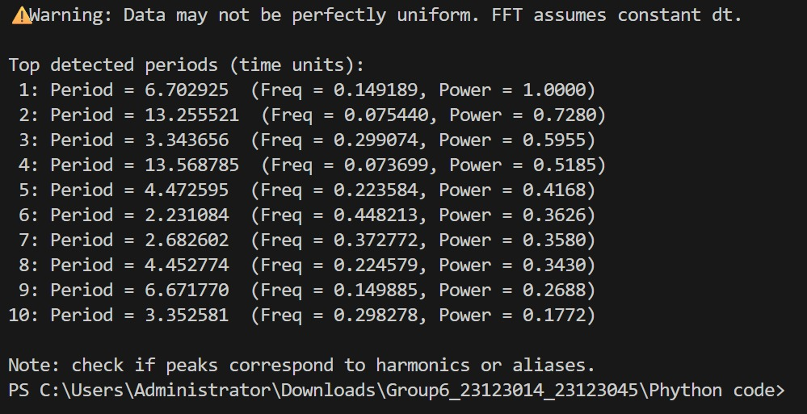
Applying Fourier Transform on the Complete Data of EPIC 249432662

Slide 23
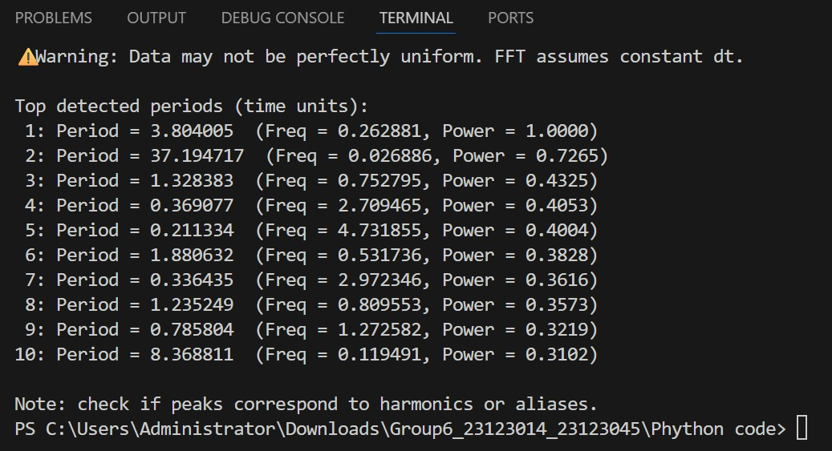
Applying Fourier Transform on a Smaller Section of EPIC 249432662
Notes:
Agar aap chahte ho ki hum aapko real-time mein code chalakar dikhaye toh kar sakte hai

Slide 24

The Link : Deriving DFT from the LSP
The Lomb-Scargle periodogram is the general case. The standard DFT periodogram is simply the LSP applied to an ideal, uniformly sampled dataset.
When Sampling is Uniform: Phase correction disappears, the sums in the $τ$ equation cancel out, forcing $τ≈0$
Normalization Terms Simplify: The denominator terms become equal, approximating $N/2$: $\sum_{n=1}^{N}{}\cos^{2}\left(ωt_{n}\right)≈\sum_{n=1}^{N}{}\sin^{2}\left(ωt_{n}\right)≈N/2$

Slide 25

The Link : Deriving DFT from the LSP
Resulting Equation (DFT Periodogram) :
Setting $τ=0$ and the denominators to $N/2$ in the LSP equation results in a form proportional to the standard DFT Periodogram power $P_{\text{DFT}}$: $P_{\text{DFT}}\left(ω\right)∝\frac{1}{N}\left\{{\left[\sum_{n=1}^{N}{\left(x_{n}−\overline{x}\right)}\cos\left(ωt_{n}\right)\right]}^{2}+{\left[\sum_{n=1}^{N}{\left(x_{n}−\overline{x}\right)}\sin\left(ωt_{n}\right)\right]}^{2}\right\}$
Conclusion : The DFT Periodogram is just a special case of Lomb-Scargle Periodogram obtained when the data is evenly sampled.

Slide 26
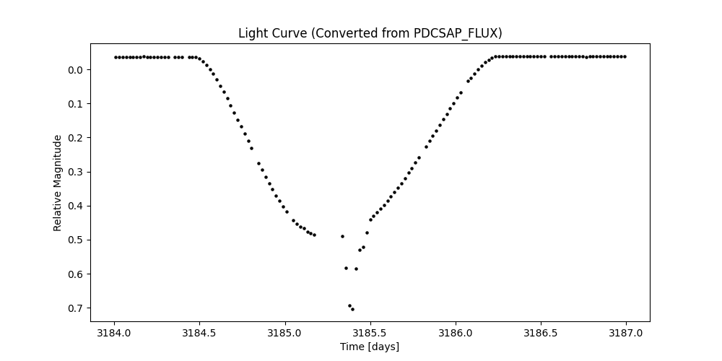
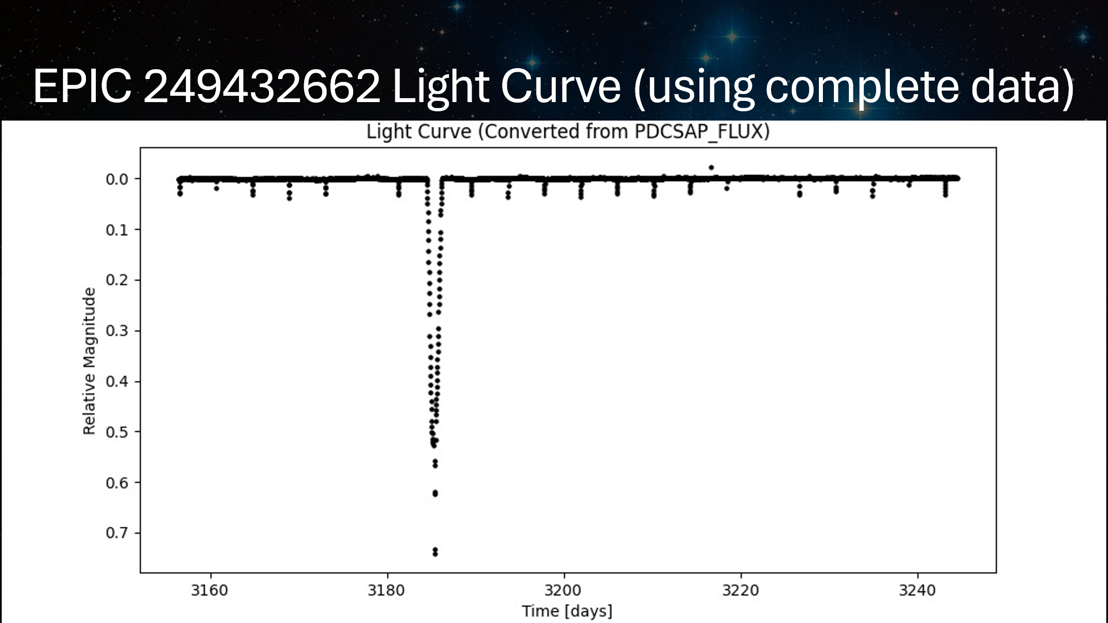
Future Scope

Slide 27
Future Scope
Multi-Star Systems : Extend the analysis to systems with more stars to capture complex orbital interactions
Model Orbital Dynamics : Determine velocity, orbital radius, eccentricity, and other such parameters
Spectroscopic Analysis : Combine with spectroscopy to determine stellar properties such as mass, temperature and composition for a complete system characterization.

Slide 28
References
Photodynamical analysis of the triply eclipsing hierarchical triple system EPIC 249432662
Data taken from MAST K2 Data Search Portal
Understanding Lomb Scargle
Background image taken from science.nasa.gov
GIF taken from Dr. Fabien Baron, Dept. of Astronomy, University of Michigan, Ann Arbor, MI 48109-1090

